Slide 1
Microwave Devices E511
Lecture 7
Amr Al.Awamry

Slide 2
Agenda
ABCD matrix revisit
Microwave resonators
SERIES AND PARALLEL RESONANT CIRCUITS
TRANSMISSION LINE RESONATORS….intro

Slide 3
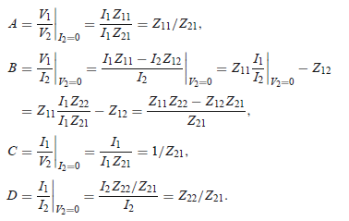
ABCD Relation to Impedance Matrix
Current notation matched with ABCD notations
Please notice table 4.2 p192

Slide 4
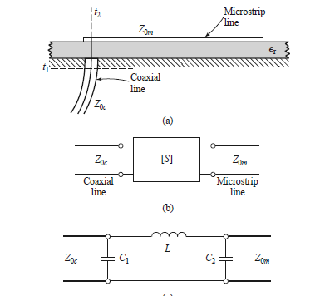
Microstrip excitation and network model

Slide 5
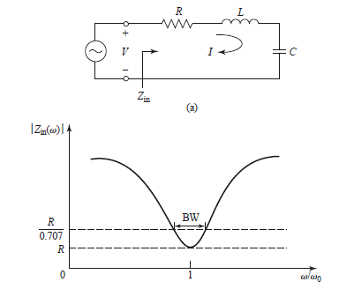
SERIES AND PARALLEL RESONANT CIRCUITS
Series Resonant Circuit

Slide 6
Series resonance cit ….cont.
Quality factor :
@ resonance
Resonator behavior around resonance frequency
If R=0 then
Bandwidth can be found as

Slide 7
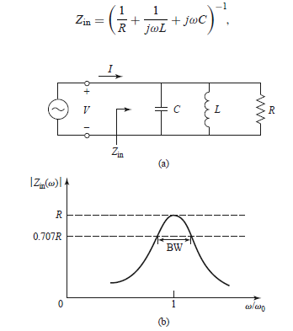
Parallel resonance cit

Slide 8
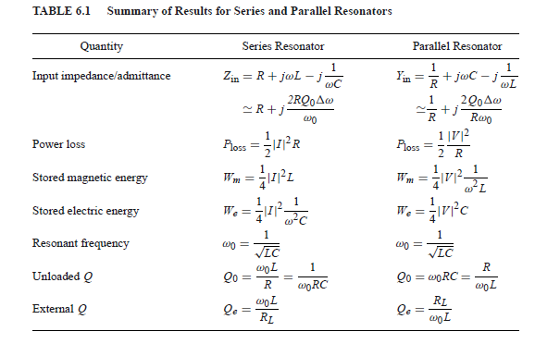
// & Series resonators summary

Slide 9
Loaded and Unloaded Q
If series Re=R+RL
If parallel Re=R//RL

Slide 10
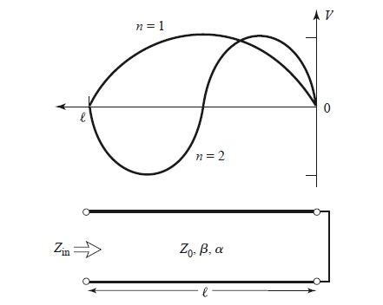
TRANSMISSION LINE RESONATORS
Short-Circuited λ/2 Line

